Slide 1
INSURANCE FRAUD DETECTION
PREPARED BY:
MOHAN KUMAR

Slide 2
INTRODUCTION
Insurance fraud detection is a challenging problem, given the variety of fraud patterns and relatively small ratio of known frauds in typical samples. ... Insurance frauds cover the range of improper activities which an individual may commit in order to achieve a favorable outcome from the insurance company
Potential situations could include:
Covering-up for a situation that wasn’t covered under insurance (e.g. drunk driving, performing risky acts, illegal activities etc.)
Misrepresenting the context of the incident: This could include transferring the blame to incidents where the insured party is to blame, failure to take agreed upon safety measures
Infiating the impact of the incident: Increasing the estimate of loss incurred either through addition of unrelated losses (faking losses) or attributing increased cost to the losses

Slide 3
Why Machine Learning in Fraud Detection?
The challenge with the above approaches is that they rely very heavily on manual intervention which will lead to the following limitations
Constrained to operate with a limited set of known parameters based on heuristic knowledge – while being aware that some of the other attributes could also infiuence decisions
Inability to understand context-specific relationships between parameters (geography, customer segment, insurance sales process) that might not refiect the typical picture. Consultations with industry experts indicate that there is no ‘typical model’, and hence challenges to determine the model specific to context
Recalibration of model is a manual exercise that has to be conducted periodically to refiect changing behavior and to ensure that the model adapts to feedback from investigations. The ability to conduct this calibration is challenging

Slide 4
PROBLEM DEFINITION
The objective of this project is to predict whether the Insurance claim is fraudulent or not
Finding out the whether the Insurance claim is fraud or not, can be solved by using these kind of features like policy_number, policy_csl, policy_deductable, policy_annual_premium, umbrella_limit, insured_education_level, capital-gain, capital-loss, property_damage, bodily_injuries, Witnesses, police_report_available, total_claim_amount, injury_claim, property_claim, vehicle_claim and many more
Implementing a model that will help insurance companies to identify whether the claim is fraudulent or not

Slide 5
Data Cleaning
Analyzed categorical features and treated missing values using categorical imputer ( imputing most frequent data into missing values)
Remove junk characters from the dataset
Performed Label encoding for the ordinal variables like insured_education_level, incident_severity.
Performed multicollinearity using heat map to find whether there are any correlated features .
Performed Custom encoding for certain features by their weightage of data provided for each columns

Slide 6
Feature Engineering
1. Dimensionality reduction :
Since there is multicollinearity in our data, We have done PCA for the dataset to reduce the dimension of the dataset
2. Grid search cv:
Performed grid search cv for finding the best parameters.
3. Optuna:
Performed Optuna hyperparameter tuning to find the best parameters for Lightgbm and catboost algorithms.

Slide 7
Models used
DecisionTreeClassifier
RandomForestClassifier
GradientBoostingClassifier
KNeighborsClassifier
AdaBoostClassifier
XGBClassifier
BalancedRandomForestClassifier
LGBMClassifier
CatBoostClassifier
SVC (Support vector classifier)

Slide 8
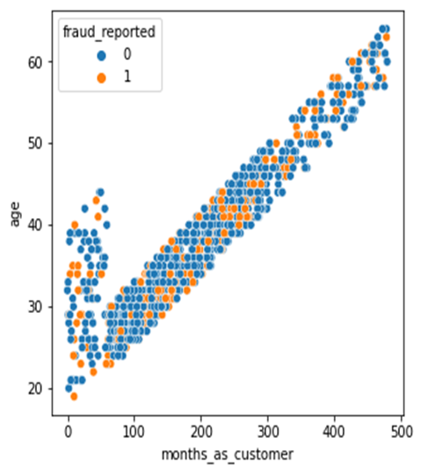
Key Findings
From the diagram we can infer that most of the Fraud claims are
Done from the age above 25 and below 45.
I would recommend business to put their efforts mostly in this age
Group

Slide 9
Predictions
Compared various algorithm to build the model and found Lightgbm and Balanced random forrest classifier was able to give better accuracy about 83%.
Balanced Random forrest classifier is the best model , because it gives the accuracy for both the classes and reduces the type 1 and type 2 error.

